Slide 1
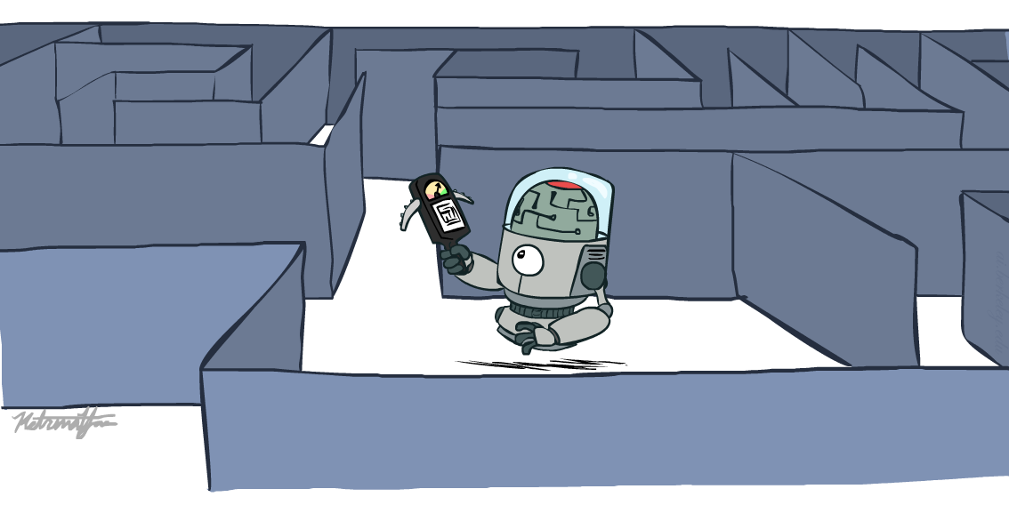
Artificial Intelligence Informed Search
CS 444 – Spring 2021
Dr. Kevin Molloy
Department of Computer Science
James Madison University
Much of this lecture is taken from
Dan Klein and Pieter Abbeel AI class at UC Berkeley

Slide 2
Announcements
HW 0 is due tonight (from last lecture and Chp 2 in Russell/Norvig).
PA 0 is due tomorrow Friday, Jan 22
PA 1 is released. You should start on the project now.
No quiz this week (want to get back some HW to you first).

Slide 3

Learning Objectives for Today
Informed Search
Heuristics
Greedy Search
A* Search
Graph Search
Figure from Berkley AI

Slide 4

Search Recap
Figure from Berkley AI

Slide 5
Search Recap
Search problem:
States (configurations of the world)
Actions and costs
Successor function (world dynamics)
Start state and goal test
Search tree:
Nodes: represent plans for reaching states
Plans have costs (sum of action costs)
Search algorithm:
Systematically builds a search tree
Chooses an ordering of the fringe (unexplored nodes)
Optimal: finds least-cost plans
Figure from Berkley AI

Slide 6
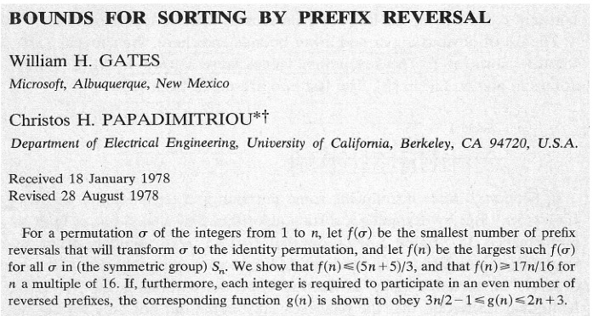
Example: Pancake Problem
Cost: Number of pancakes flipped
Figure from Berkley AI
Notes:
Gates, W. and Papadimitriou, C., "Bounds for Sorting by Prefix Reversal.", Discrete Mathematics. 27, 47-57, 1979.

Slide 7
Example: Pancake Problem
State space graph with costs as weights
4
2
3
2
3
4
3
4
2
3
2
2
4
3
Figure from Berkley AI
Notes:
A* expanded 8100 ; Path cost = 33
UCS expanded 25263 . Path cost = 33
Greedy expanded 10 . Path cost = 41
[0, 7, 5, 3, 2, 1, 4, 6]
(7, 0, 5, 3, 2, 1, 4, 6)
(6, 4, 1, 2, 3, 5, 0, 7)
(3, 2, 1, 4, 6, 5, 0, 7)
(1, 2, 3, 4, 6, 5, 0, 7)
(5, 6, 4, 3, 2, 1, 0, 7)
(6, 5, 4, 3, 2, 1, 0, 7)
(0, 1, 2, 3, 4, 5, 6, 7)

Slide 8
General Tree Search
Action: flip top two Cost: 2
Action: flip all four Cost: 4
Path to reach goal:
Flip four, flip three
Total cost: 7
Figure from Berkley AI
Notes:
You know exactly where you came from and how you got there, but you have no idea where you’re going. But, you’ll know it when you see it.

Slide 9
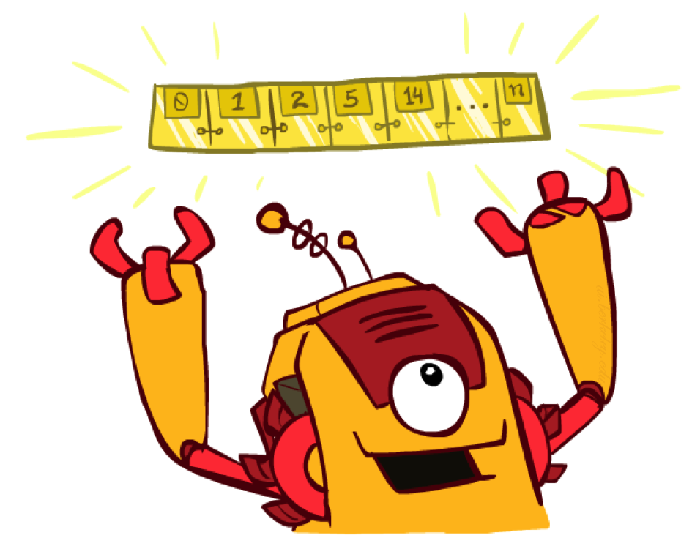
Search – Only Differences are in the Queue
All these search algorithms are the same except for fringe strategies
Conceptually, all fringes are priority queues (i.e. collections of nodes with attached priorities)
Practically, for DFS and BFS, you can avoid the log(n) overhead from an actual priority queue, by using stacks and queues
Can even code one implementation that takes a variable queuing object
Figure from Berkley AI

Slide 10
Uniform Cost Search
Strategy: expand lowest path cost
The good: UCS is complete and optimal!
The bad:
Explores options in every “direction”
No information about goal location
c ≤ 1
…
c ≤ 2
c ≤ 3
Start
Goal
Figure from Berkley AI

Slide 11

Informed Search
Figure from Berkley AI

Slide 12



Search Heuristic
A heuristic is:
A function that estimates how close a state is to a goal
Designed for a particular search problem
Examples: Manhattan distance, Euclidean distance for pathing
10
5
11.2
Figure from Berkley AI

Slide 13
Example: Heuristic Function
h(x)
Figure from Berkley AI

Slide 14
Example: Heuristic Function
3
h(x)
4
3
4
3
0
4
4
3
4
4
2
3
Figure from Berkley AI

Slide 15

Greedy Search
Figure from Berkley AI

Slide 16
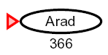

Greedy Search
Expand the node that seems closest…
What can go wrong?
Figure from Berkley AI

Slide 17
Greedy Search
b
Strategy: expand a node that you think is closest to a goal state
Heuristic: estimate of distance to nearest goal for each state
A common case:
Best-first takes you straight to the (wrong) goal
Worst-case: like a badly-guided DFS
…
b
…
Figure from Berkley AI

Slide 18



A* Search
UCS
Greedy
A*
Figure from Berkley AI

Slide 19
Combining UCS and Greedy
Uniform-cost orders by path cost, or backward cost g(n)
Greedy orders by goal proximity, or forward cost h(n)
A* Search orders by the sum: f(n) = g(n) + h(n)
8
g = 0 h=6
S
e
h=1
g = 1 h=5
a
1
1
3
2
g = 2 h=6
g = 9 h=1
S
a
d
G
b
d
g = 4 h=2
e
h=6
1
h=5
h=2
h=0
1
g = 3 h=7
g = 6 h=0
g = 10 h=2
c
b
c
G
d
h=7
h=6
g = 12 h=0
G
Example from Teg Grenager

Slide 20
When should A* terminate?
Should we stop when we enqueue a goal?
No: only stop when we dequeue a goal
h = 2
A
2
2
S
h = 3
h = 0
G
2
B
3
h = 1
Figure from Berkley AI

Slide 21
Is A* Optimal?
h = 6
1
A
3
S
h = 7
G
h = 0
5
What went wrong?
Actual bad goal cost < estimated good goal cost
We need estimates to be less than actual costs!
Figure from Berkley AI

Slide 22


Idea: Admissibility
Inadmissible (pessimistic) heuristics break optimality by trapping good plans on the fringe
Admissible (optimistic) heuristics slow down bad plans but never outweigh true costs
Figure from Berkley AI

Slide 23


Admissible Heuristics
A heuristic h is admissible (optimistic) if:
where is the true cost to a nearest goal
Examples:
Coming up with admissible heuristics is most of what’s involved in using A* in practice.
4
15
Figure from Berkley AI

Slide 24


Optimality of A* Tree Search
Assume:
A is an optimal goal node
B is a suboptimal goal node
h is admissible
Claim:
A will exit the fringe before B
…
Figure from Berkley AI

Slide 25


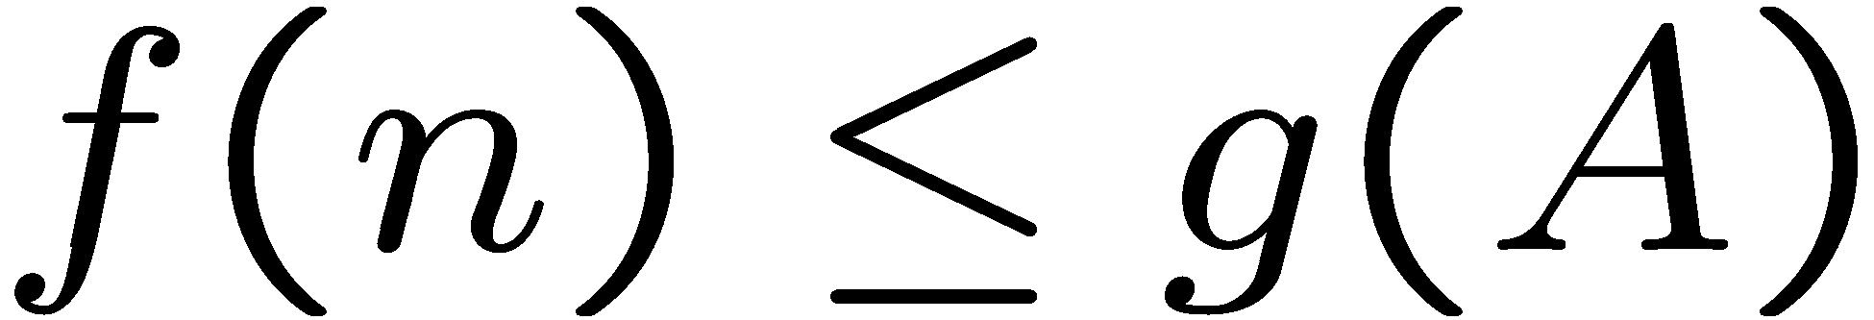
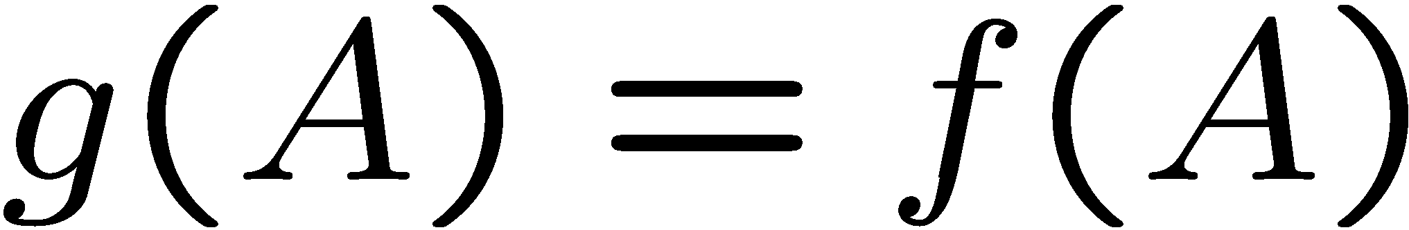
Optimality of A* Tree Search: Blocking
Proof:
Imagine B is on the fringe
Some ancestor n of A is on the fringe, too (maybe A!)
Claim: n will be expanded before B
f(n) is less or equal to f(A)
…
Definition of f-cost
Admissibility of h
h = 0 at a goal
Figure from Berkley AI

Slide 26


Optimality of A* Tree Search: Blocking
Proof:
Imagine B is on the fringe
Some ancestor n of A is on the fringe, too (maybe A!)
Claim: n will be expanded before B
f(n) is less or equal to f(A)
f(A) is less than f(B)
…
B is suboptimal
h = 0 at a goal
Figure from Berkley AI

Slide 27

Optimality of A* Tree Search: Blocking
Proof:
Imagine B is on the fringe
Some ancestor n of A is on the fringe, too (maybe A!)
Claim: n will be expanded before B
f(n) is less or equal to f(A)
f(A) is less than f(B)
n expands before B
All ancestors of A expand before B
A expands before B
A* search is optimal
…
Figure from Berkley AI

Slide 28
Properties of A*
Uniform-Cost
A*
b
b
…
…
Figure from Berkley AI

Slide 29
Uniform-Cost versus A* Contours
Uniform-cost expands equally in all “directions”
A* expands mainly toward the goal, but does hedge its bets to ensure optimality
Start
Goal
Start
Goal
Figure from Berkley AI

Slide 30



Pacman Comparison
Greedy
Uniform Cost
A*
Figure from Berkley AI

Slide 31
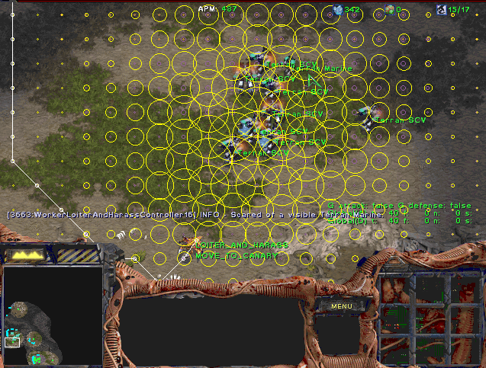
A* Applications
Video games
Pathing / routing problems
Resource planning problems
Robot motion planning
Language analysis
Machine translation
Speech recognition
…
Figure from Berkley AI

Slide 32
A*: Creating Admissible Heuristics
Most of the work in solving hard search problems optimally is in coming up with admissible heuristics
Often, admissible heuristics are solutions to relaxed problems, where new actions are available
Inadmissible heuristics are often useful too
366
15
Figure from Berkley AI

Slide 33
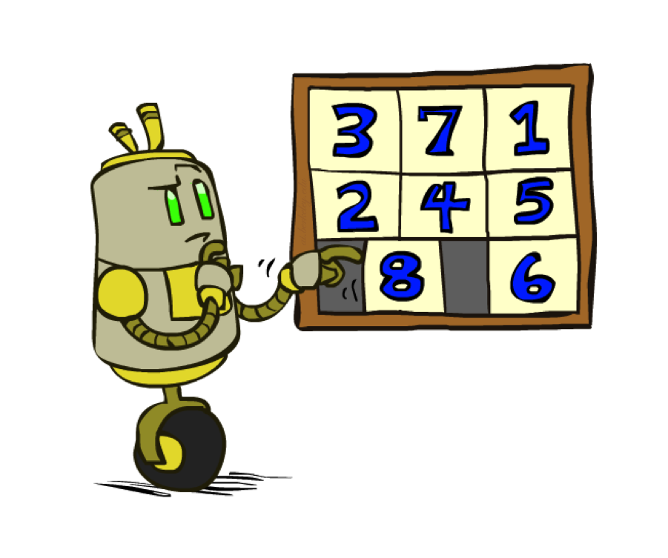
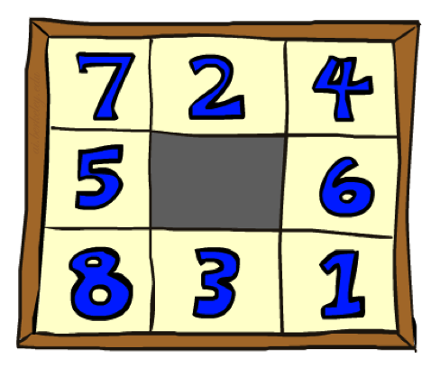
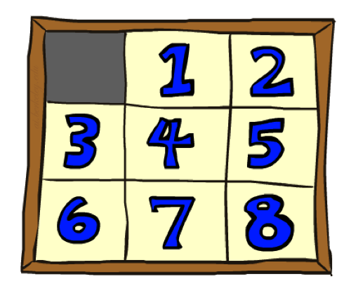
Example: 8 Puzzle
Start State
Actions
Goal State
What are the states?
How many states?
What are the actions?
How many successors from the start state?
What should the costs be?
Figure from Berkley AI

Slide 34
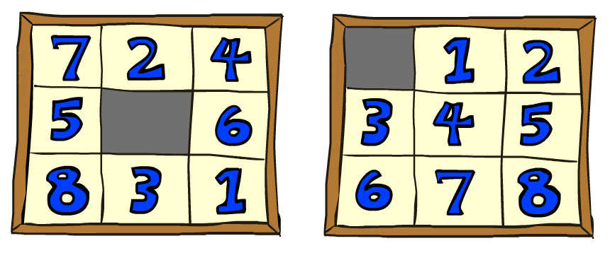
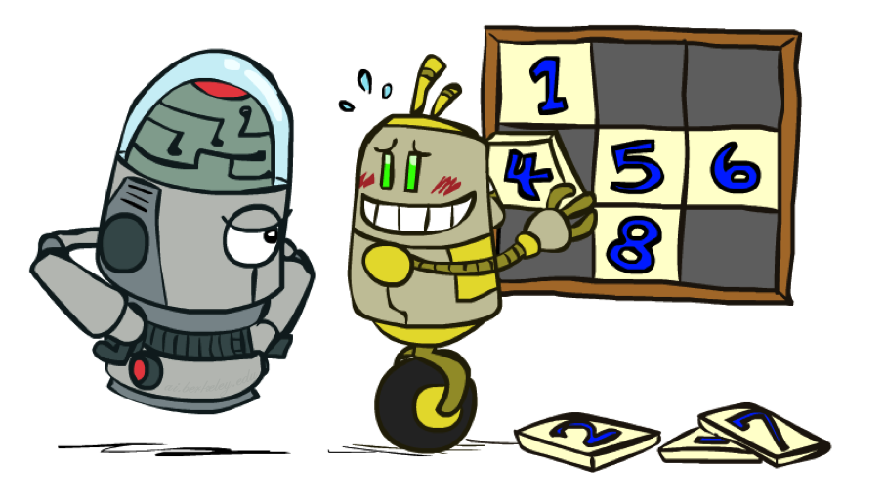
8 Puzzle: Heuristic I
Heuristic: Number of tiles misplaced
Why is it admissible?
h(start) =
This is a relaxed-problem heuristic
8
Start State
Goal State
 | Average nodes expanded when the optimal path has…
 | …4 steps | …8 steps | …12 steps
UCS | 112 | 6,300 | 3.6 x 10⁶
TILES | 13 | 39 | 227
Figure from Berkley AI; Statistics from Andrew Moore

Slide 35
8 Puzzle: Heuristic II
What if we had an easier 8-puzzle where any tile could slide any direction at any time, ignoring other tiles?
Total Manhattan distance
Why is it admissible?
h(start) =
Start State
Goal State
 | Average nodes expanded when the optimal path has…
 | …4 steps | …8 steps | …12 steps
TILES | 13 | 39 | 227
MANHATTAN | 12 | 25 | 73
3 + 1 + 2 + … = 18
Figure from Berkley AI

Slide 36
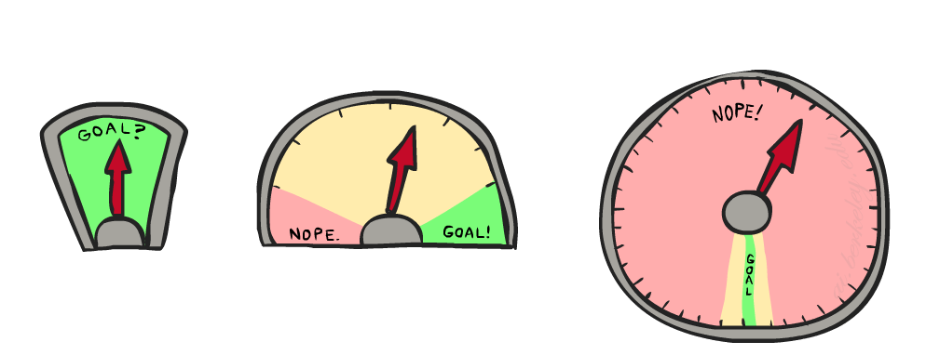
8 Puzzle: Heuristic III
How about using the actual cost as a heuristic?
Would it be admissible?
Would we save on nodes expanded?
What’s wrong with it?
With A*: a trade-off between quality of estimate and work per node
As heuristics get closer to the true cost, you will expand fewer nodes but usually do more work per node to compute the heuristic itself
Figure from Berkley AI

Slide 37

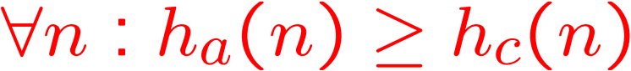
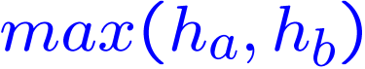

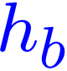
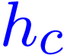

Trivial Heuristics and Dominance
Dominance: h_{a} ≥ h_{c} if
Heuristics form a semi-lattice:
Max of admissible heuristics is admissible
Trivial heuristics
Bottom of lattice is the zero heuristic (what does this give us?)
Top of lattice is the exact heuristic
Figure from Berkley AI

Slide 38
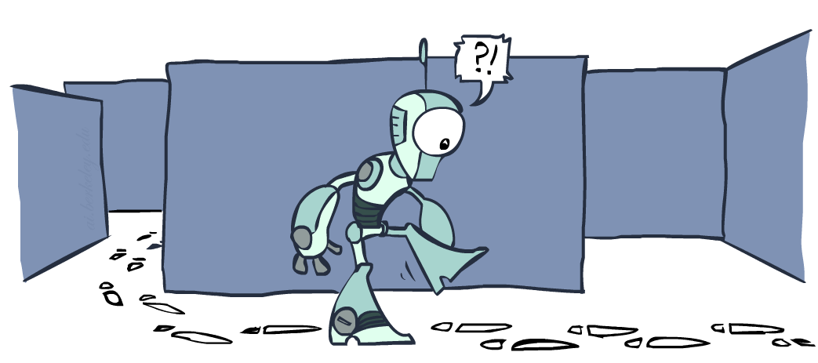
Graph Search
Figure from Berkley AI

Slide 39
Tree Search: Extra Work!
Failure to detect repeated states can cause exponentially more work.
State Graph
Search Tree
Figure from Berkley AI

Slide 40
Graph Search
In BFS, for example, we shouldn’t bother expanding the circled nodes (why?)
S
d
e
p
b
c
e
h
r
q
a
a
h
r
p
q
f
p
q
f
q
c
G
q
c
G
a
a
Figure from Berkley AI

Slide 41
Graph Search Motivation
Idea: never expand a state twice
How to implement:
Tree search + set of expanded states (“closed set”)
Expand the search tree node-by-node, but…
Before expanding a node, check to make sure its state has never been expanded before
If not new, skip it, if new add to closed set
Important: store the closed set as a set, not a list
Can graph search wreck completeness? Why/why not?
How about optimality?
Figure from Berkley AI

Slide 42
A* Graph Search Gone Wrong!
State space graph
Search tree
A
S (0+2)
1
S
1
C
h=4
h=1
A (1+4)
B (1+1)
h=2
1
2
B
3
C (2+1)
C (3+1)
h=1
G
G (5+0)
G (6+0)
h=0
Figure from Berkley AI

Slide 43
Consistency of Heuristics
Main idea: estimated heuristic costs ≤ actual costs
Admissibility: heuristic cost ≤ actual cost to goal
h(A) ≤ actual cost from A to G
Consistency: heuristic “arc” cost ≤ actual cost for each arc
h(A) – h(C) ≤ cost(A to C)
Consequences of consistency:
The f value along a path never decreases
h(A) ≤ cost(A to C) + h(C)
A* graph search is optimal
A
1
C
h=4
h=1
h=2
3
G
Figure from Berkley AI

Slide 44
Optimality of A* Graph Search
Sketch: consider what A* does with a consistent heuristic:
Fact 1: In tree search, A* expands nodes in increasing total f value (f-contours)
Fact 2: For every state s, nodes that reach s optimally are expanded before nodes that reach s suboptimally
Result: A* graph search is optimal
…
f ≤ 1
f ≤ 2
f ≤ 3
Figure from Berkley AI

Slide 45

Optimality
Tree search:
A* is optimal if heuristic is admissible
UCS is a special case (h = 0)
Graph search:
A* optimal if heuristic is consistent
UCS optimal (h = 0 is consistent)
Consistency implies admissibility
In general, most natural admissible heuristics tend to be consistent, especially if from relaxed problems
Figure from Berkley AI

Slide 46

A* Summary
A* uses both backward costs and (estimates of) forward costs
A* is optimal with admissible / consistent heuristics
Heuristic design is key: often use relaxed problems
Figure from Berkley AI

Slide 47
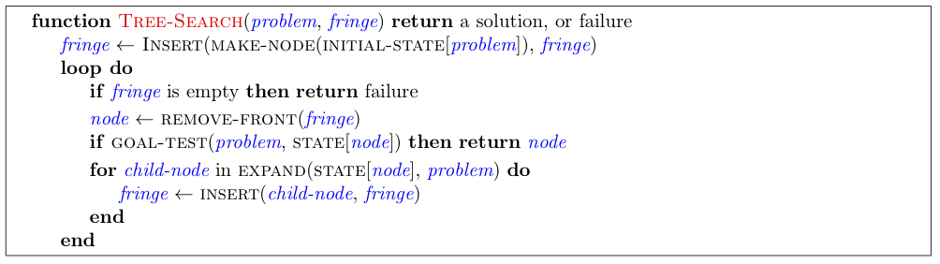
Tree Search Pseudo-Code
Figure from Berkley AI

Slide 48
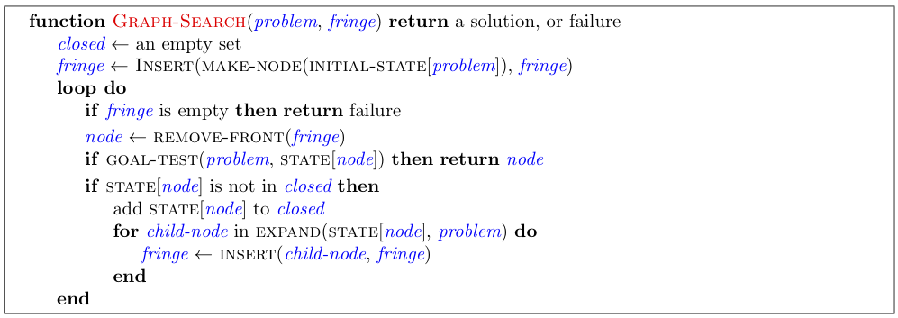
Graph Search Pseudo-Code
Figure from Berkley AI

Slide 49
Informed Search
Figure from Berkley AI

